Slide 1
Maps, Geocoding, and Location-Based Services

Slide 2
Contents
Add Google Map to Android application
Google Map methods
Access phone’s position

Slide 3
Add Google Map to Android application
Add Google Play Services to project
Add MapFragment
Get an API key
Add permission to AndroidManifest.xml
Wait for map to be ready

Slide 4
Step 1: Add Google Play Services to project
add Google Play to project in app's build.gradle file
dependencies {
implementation fileTree(dir: 'libs', include: ['*.jar’])
implementation 'com.google.android.gms:play-services:18.0.0’
}

Slide 5
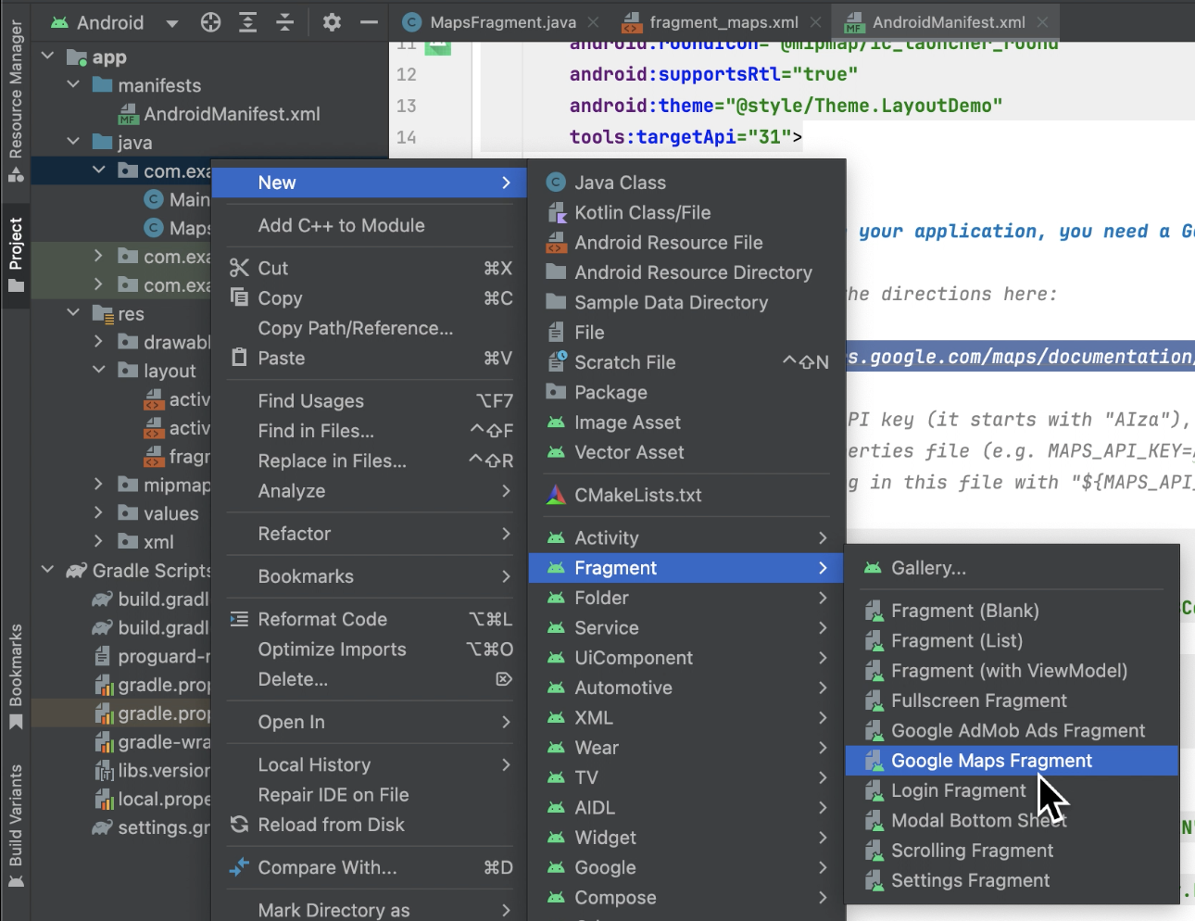
2. Add MapFragment

Slide 6
Step 2: Add MapFragment
Google Maps API provides a fragment class named MapFragment for displaying a map within an activity.
<?xml version="1.0" encoding="utf-8"?> <fragment xmlns:android="http://schemas.android.com/apk/res/android" xmlns:tools="http://schemas.android.com/tools" android:id="@+id/map" android:name="com.google.android.gms.maps.SupportMapFragment" android:layout_width="match_parent" android:layout_height="match_parent" tools:context=".MapsFragment" />

Slide 7
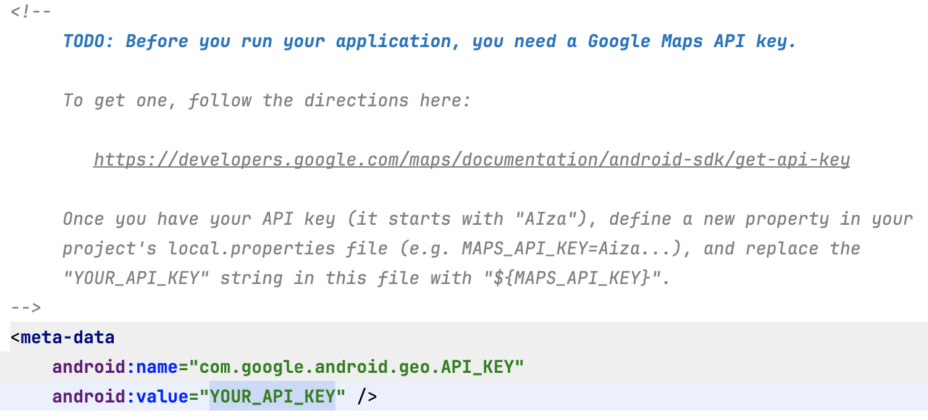
Step 2: Add MapFragment
After add fragment, some codes is generated as below
Include the direction link and meta-data

Slide 8
Step 2: Add MapFragment
Go to the link from the direcdtion from manifest file https://developers.google.com/maps/documentation/android-sdk/get-api-key
Go to the google console to create project, put SHA-1 (step 3)

Slide 9
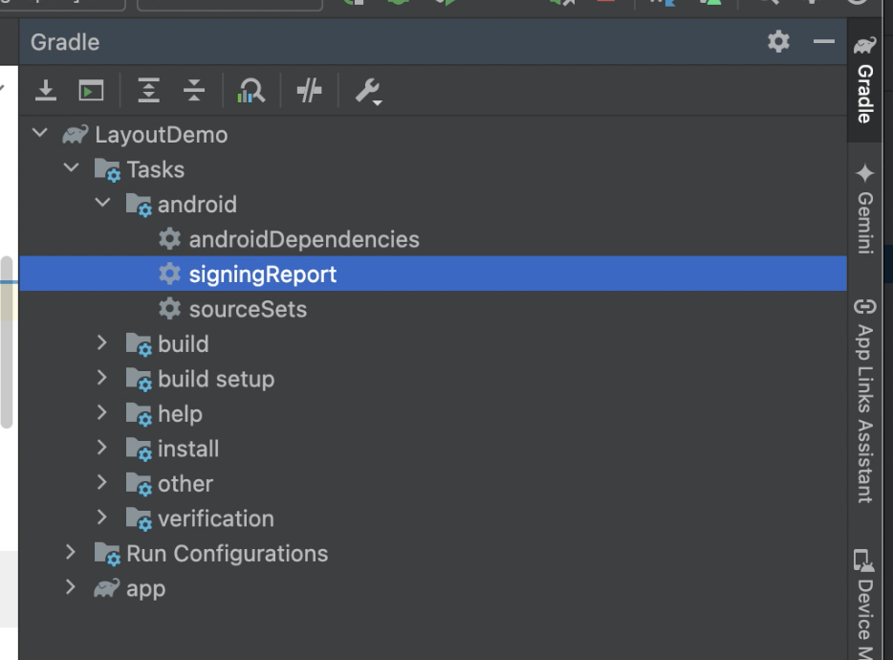
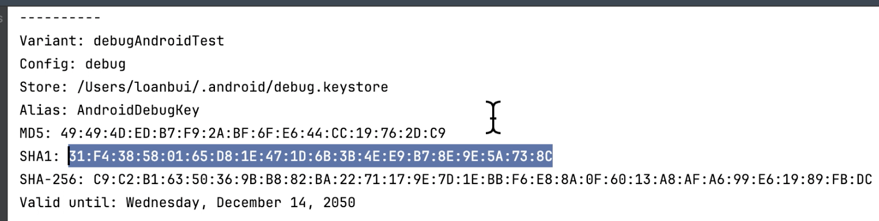
Step 3: Get an API key
Google won't allow you to fetch map data without an API key.
Get SHA1 key
By running signingReport from android studio.

Slide 10
Step 3: Get an API key
Other way to get SHA1 key, open a Terminal and find the file debug.keystore:
Windows (new): C:\Users\USERNAME\.android
Windows (old): C:\Documents and Settings\USERNAME\.android
Linux: /home/USERNAME/.android/
Mac: /Users/USERNAME/.android/
In the terminal or command prompt, cd to that directory, then type and run:
keytool -list -v -keystore debug.keystore
(it asks for a password, so just press Enter)
Find the line with your "Certificate fingerprint" for "SHA-1". It should contain a long string in this format. Copy it down.
BD:2B:3F:4B:.........

Slide 11
Step 3: Get an API key
Second: Go to the Google APIs developer console:
Create project
Link: https://code.google.com/apis/console/
Enable API
choose Android Key
paste in the SHA-1 key you got from the previous slide

Slide 12
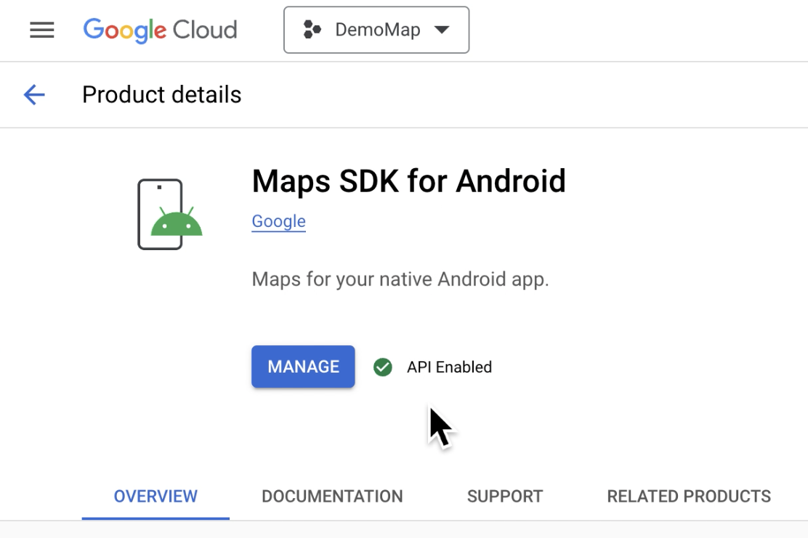
Step 3: Get an API key
After create project
And enable API

Slide 13
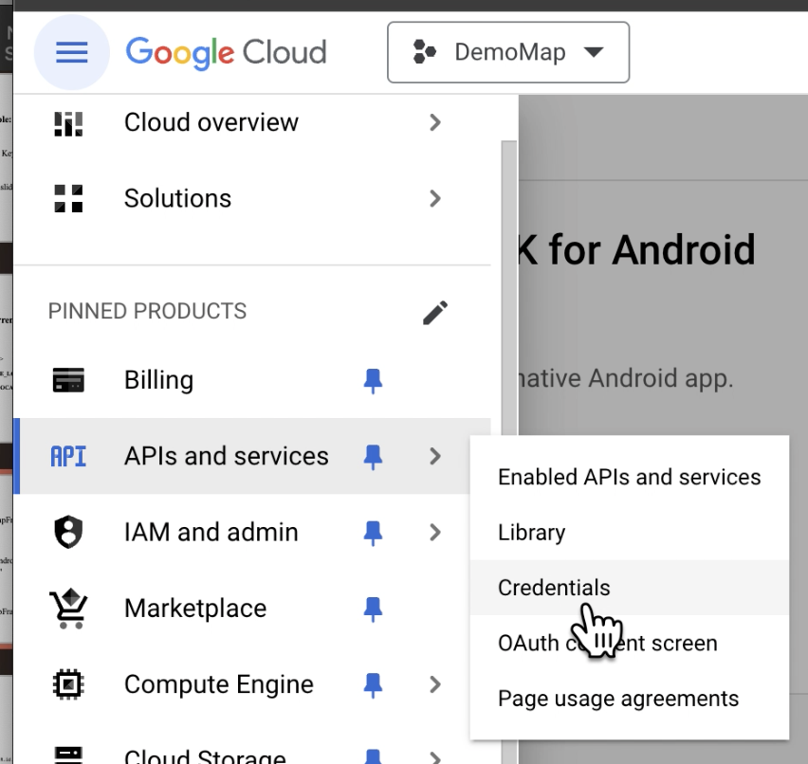
Step 3: Get an API key
Cancel billing and select
“Credentails” from menu

Slide 14
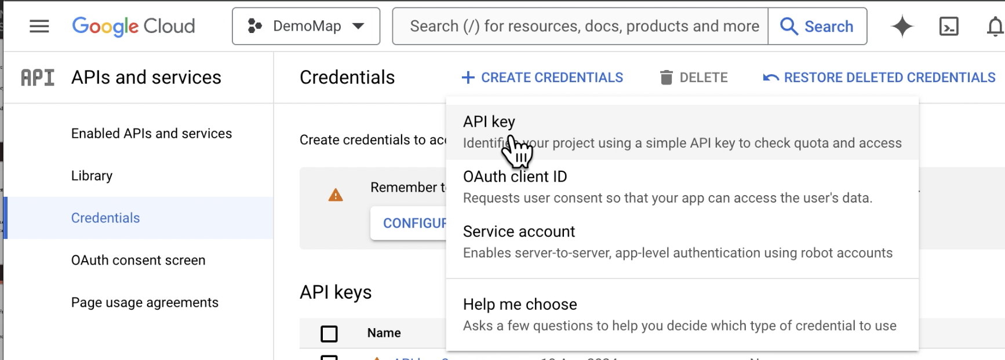
Step 3: Get an API key
Create API key

Slide 15
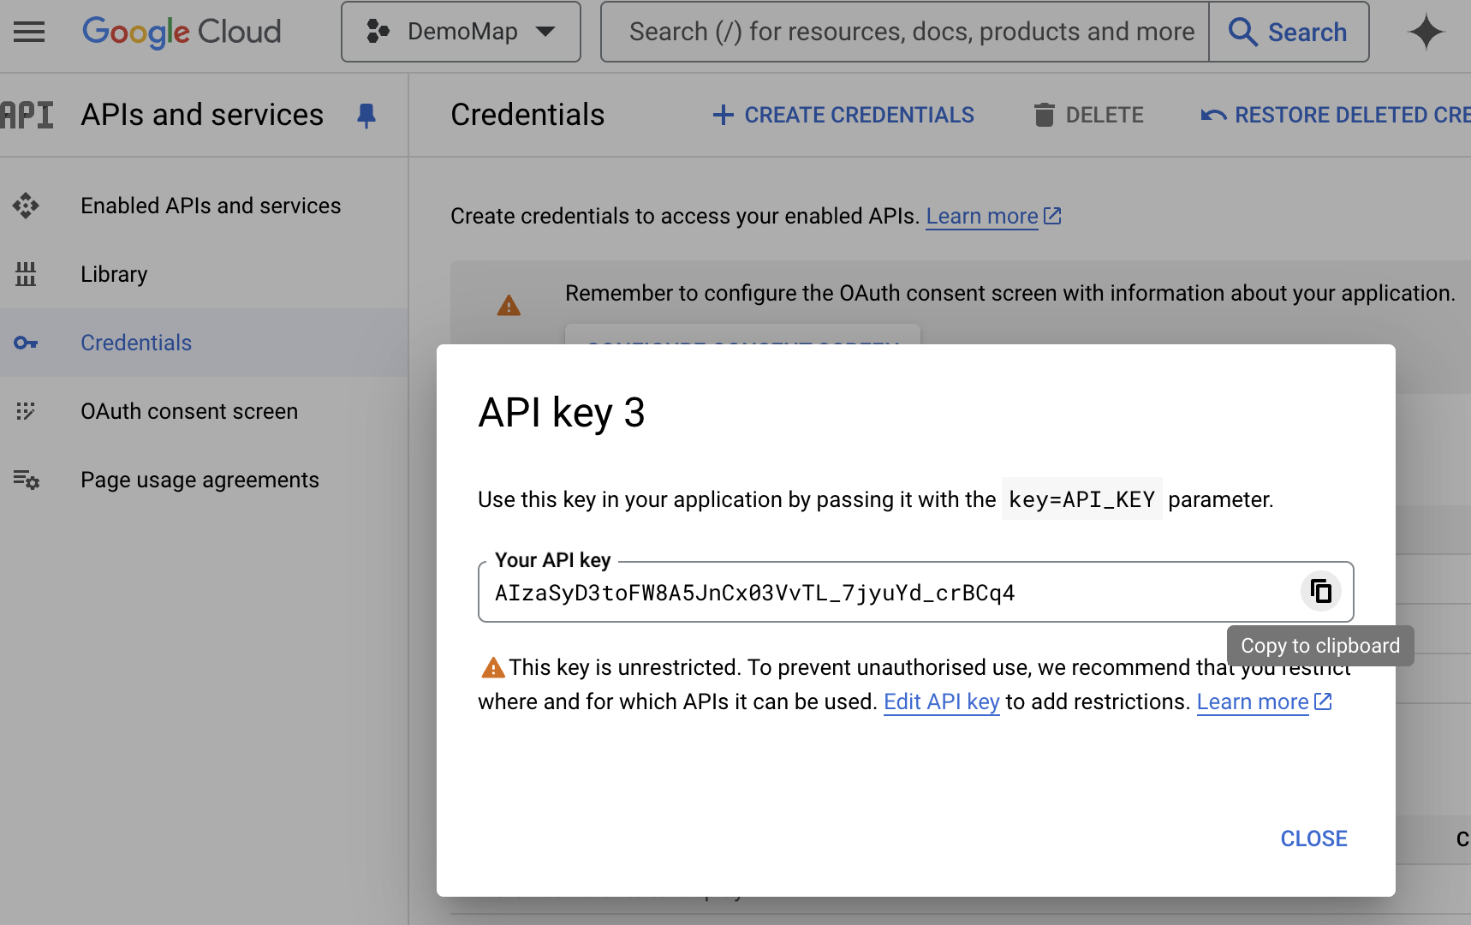
Step 3: Get an API key
Key generated
Copy it and patse to
The manifest file

Slide 16
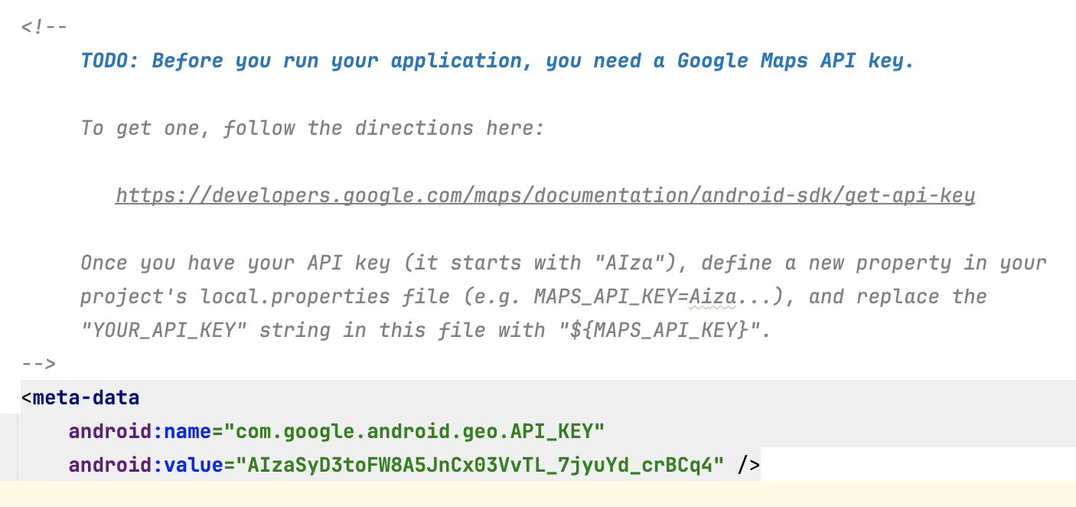
Step 3: Get an API key
Key is patsed to meta-data

Slide 17
Step 4. AndroidManifest.xml add permissions
Because of privacy issues, to access phone's current location, must request permission in AndroidManifest.xml:
<manifest ...>
<uses-permission android:name="android.permission.INTERNET" />
<uses-permission
android:name="android.permission.ACCESS_COARSE_LOCATION" />
<uses-permission
android:name="android.permission.ACCESS_FINE_LOCATION" />
<application ...>
...
</application>
</manifest>

Slide 18
Step 4. AndroidManifest.xml add permissions
ACCESS_COARSE_LOCATION Permission:
Purpose: allows an app to access approximate location based on network sources such as cell towers and Wi-Fi. The location obtained is less precise than using GPS but consumes less power.
Typical Usage: Apps that require location services but do not need pinpoint accuracy may request this permission. Examples include weather only need to know which city or area you are in rather than your exact position.
ACCESS_FINE_LOCATION Permission:
Purpose: allows an app to access precise location data, typically from GPS, but it can also include data from Wi-Fi and mobile networks to provide a highly accurate location.
Typical Usage: Apps that require precise location tracking, such as navigation apps (e.g., Google Maps) or apps with geotagging features.

Slide 19
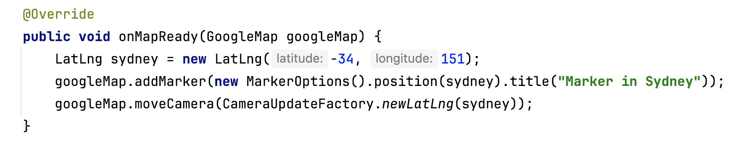
Step 5: Wait for map to be ready

Slide 20
GoogleMap methods
placing items on the map:
addCircle, addGroundOverlay, addMarker, addPolygon, addPolyline, addTileOverlay
clear - Removes all markers, polylines/polygons, overlays
manipulating the camera:
getCameraPosition, moveCamera, animateCamera, stopAnimation
map settings and appearance:
setBuildingsEnabled, setIndoorEnabled, setMapType, setPadding, setTrafficEnabled

Slide 21
GoogleMap methods
snapshot - take a screen shot of the map as a bitmap
event listeners:
setOnCameraChangeListener, setOnMapClickListener, setOnMapLoadedCallback, setOnMapLongClickListener, setOnMarkerClickListener, setOnMarkerDragListener, setOnMyLocationChangeListener

Slide 22
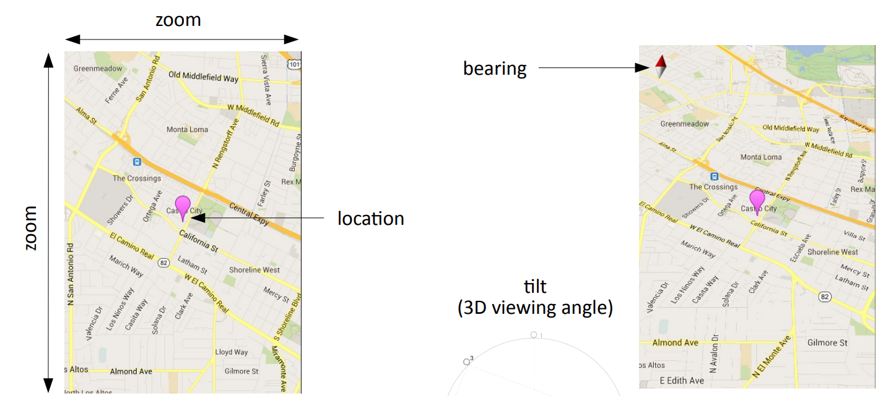
The map's camera
The current viewing window of a map's camera is defined by:
target location (latitude/longitude), zoom (2.0 - 21.0),
bearing (orientation/rotation), and tilt (degrees)

Slide 23
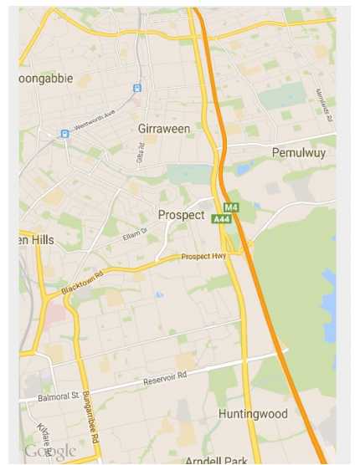
Set camera in XML
Set initial map settings and camera position in the layout XML:
<fragment ...
android:name="com.google.android.gms.maps.MapFragment"
android:id="@+id/ID"
map:cameraBearing="112.5"
map:cameraTargetLat="-33.796923"
map:cameraTargetLng="150.922433"
map:cameraTilt="30"
map:cameraZoom="13"
map:mapType="normal"
map:uiCompass="false"
map:uiRotateGestures="true"
map:uiScrollGestures="false"
map:uiTiltGestures="true"
map:uiZoomControls="false"
map:uiZoomGestures="true" />

Slide 24
Set camera in Java code
CameraUpdateFactory methods:
newLatLng(new LatLng(lat, lng))
newLatLngBounds(new LatLngBounds(SW, NE), padding)
newLatLngZoom(new LatLng(lat, lng), zoom)
newCameraPosition(CameraPosition)
others:
LatLngBounds bounds = new LatLngBounds(
new LatLng(20, -130.0), // SW
new LatLng(55, -70.0)); // NE
map.moveCamera(CameraUpdateFactory.newLatLngBounds(bounds, 50));

Slide 25
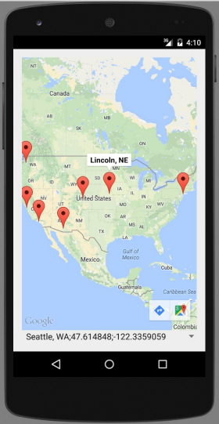
Placing markers
A GoogleMap object has an addMarker method that can let you put "push pin" markers at locations on the map.
The marker's methods return the marker, so you can chain them.
options: alpha, draggable, icon, position, rotation, title, visible, ...
map.addMarker(new MarkerOptions()
.position(new LatLng(40.801, -96.691))
.title("Lincoln, NE") );
Marker mark = map.addMarker(new MarkerOptions() ...);
mark.remove();

Slide 26
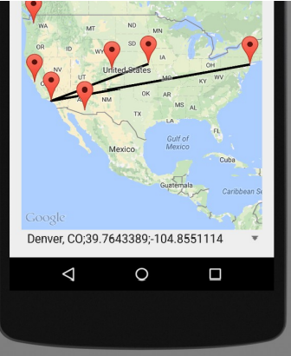
Lines and paths
A GoogleMap object has an addPolyline method that can let you put lines between locations on the map.
options: color, visible, width, zIndex, ...
map.addPolyline(new PolylineOptions()
.add(new LatLng(40.801, -96.691)) // Lincoln, NE
.add(new LatLng(34.020, -118.412)) // Los Angeles, CA
.add(new LatLng(40.703, -73.980)) // New York, NY
);
Polyline polly = map.addPolyline(...); polly.remove();

Slide 27
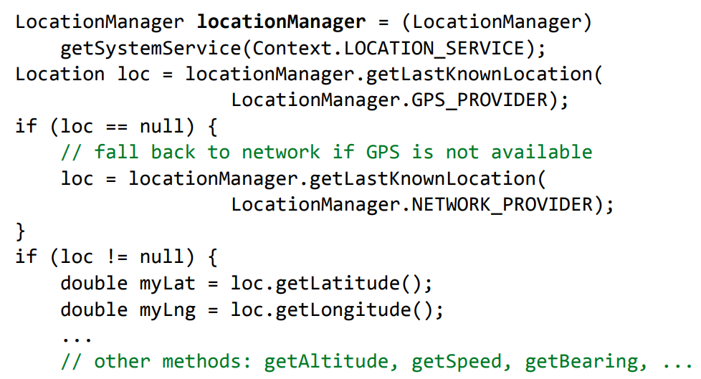
Accessing phone's location
Android LocationManager gives you the phone's position:
GPS provider provides highest accuracy
Network provider is a fallback in case GPS is disabled / not present

Slide 28
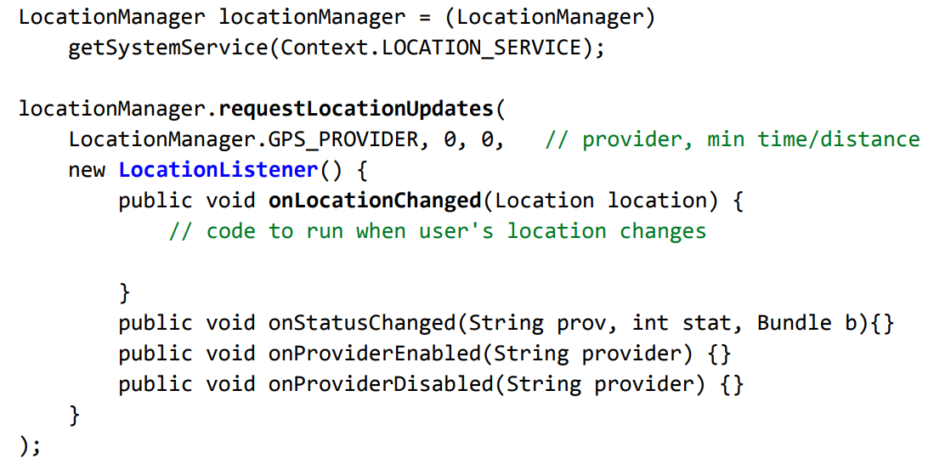
Location update events
Track user's movement by listening for location update events

Slide 29
Classwork
Create a Google Map screen
Create a marker showing your current location on the Map

Slide 30
References
CS 193A Standford course - Marty Stepp and Stanford Computer Science
https://developers.google.com/maps/documentation/android-sdk/map-with-marker

